Slide 1
Agile and Agility with Jira
Madhab Acharya
Web Developer @rasello
Notes:
What is agile, and how can we acheive a gility using jira.

Slide 2
Agile
Agile software development refers to a group of software development methodologies based on iterative development, where requirements and solutions evolve through collaboration between self-organizing cross-functional teams.
#reference cprime.com

Slide 3
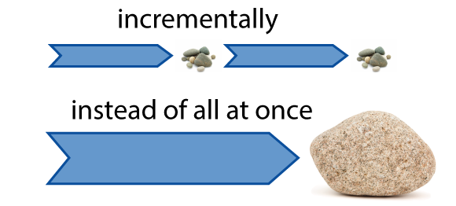
In short.

Slide 4
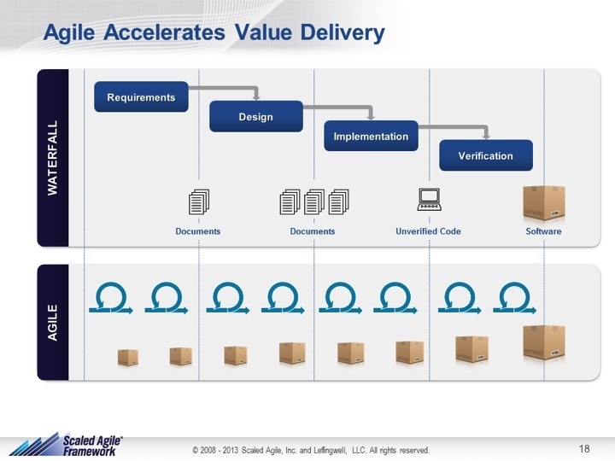
Agile vs Traditional methodologies

Slide 5
Not all projects are suitable for agile.
Agile
eg. Smarttel Android/Web App
Linear or waterfall model.
eg. Smarttel Ios App
Notes:
Smarttel web app had a lot of changes,
Many milestones,
Every once or twice a month we have to show the demo and get feedback.
Ios app,
There wouldn’t be much changes and features are likely to be same.
Particularly this model is helpful for projects when we are upgrading the product.

Slide 6
Agile Methodologies
Scrum
Extreme Programming
Dynamic Systems Development Method (DSDM)
Feature-Driven Development (FDD)
…
Notes:
1.

Slide 7
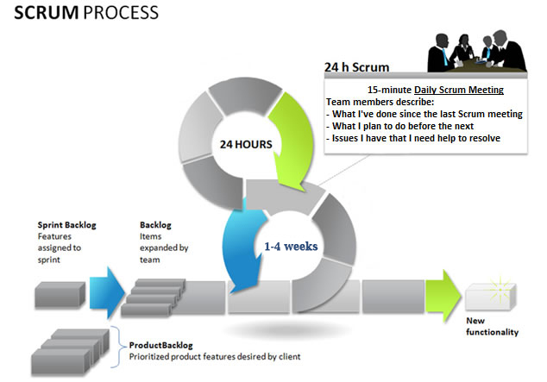

Slide 8
3 Roles
Product owner
Scrum Master
Team (Developers, testers, writers)
Notes:
In Scrum there are 3 key roles that are needed for the framework to work well.
Roles:
Product Owner : Responsible for defining the features that are needed in the product.
Scrum Master : Leader of the team. Responsible for protecting the team, and process. Running the meetings and keeping things going.
Team: Helps in building a product. Team works to get the product done.
Artifacts:
Product Backlog: Product owner create a list of potential user features , called stories that could go into the product. These list can evolves and changes priority in every sprints.
Sprint Backlog: Higher priority user stories goes into the sprint backlog. These get estimated in size and commited in next sprint.
Burndown chart: Burndown chart shows the progress in the sprint and shows the completion of task in the sprint backlog. This chats goes to the zero point once sprint is completed.
Cer

Slide 9
3 Artifacts
Product Backlog
Sprint Backlog
Burndown Chart
Notes:
In Scrum there are 3 key roles that are needed for the framework to work well.
Roles:
Product Owner : Responsible for defining the features that are needed in the product.
Scrum Master : Leader of the team. Responsible for protecting the team, and process. Running the meetings and keeping things going.
Team: Helps in building a product. Team works to get the product done.
Artifacts:
Product Backlog: Product owner create a list of potential user features , called stories that could go into the product. These list can evolves and changes priority in every sprints.
Sprint Backlog: Higher priority user stories goes into the sprint backlog. These get estimated in size and commited in next sprint.
Burndown chart: Burndown chart shows the progress in the sprint and shows the completion of task in the sprint backlog. This chats goes to the zero point once sprint is completed.
Cer

Slide 10
3 Ceremonies
Spring Planning
Daily Scrum
Spring Review
Notes:
In Scrum there are 3 key roles that are needed for the framework to work well.
Roles:
Product Owner : Responsible for defining the features that are needed in the product.
Scrum Master : Leader of the team. Responsible for protecting the team, and process. Running the meetings and keeping things going.
Team: Helps in building a product. Team works to get the product done.
Artifacts:
Product Backlog: Product owner create a list of potential user features , called stories that could go into the product. These list can evolves and changes priority in every sprints.
Sprint Backlog: Higher priority user stories goes into the sprint backlog. These get estimated in size and commited in next sprint.
Burndown chart: Burndown chart shows the progress in the sprint and shows the completion of task in the sprint backlog. This chats goes to the zero point once sprint is completed.
Ceremonies that make up scrum : think of these as meeting or discussion
Spring Planning: Product owner, scrum master and team meet and discuss the user stories and their relative sizes.
Daily Scrum: Team discussess what they have completed, What they are working on, anything that might have blocked and need help.
Spring Review: Retro spective occurs at the end of the sprint.Team demonstrates the completed work, and they discuss what can be done to make it better.

Slide 12
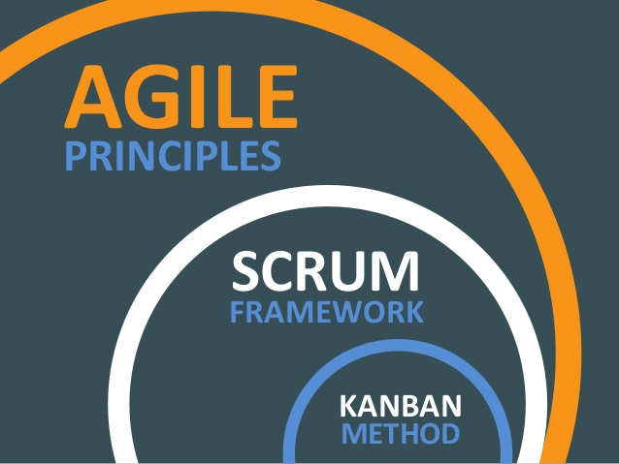
Summary

Slide 13
REFERENCES
http://www.agilenutshell.com
https://www.cprime.com
https://www.youtube.com/watch?v=9TycLR0TqFA

